Slide 1
8. Transformers and Deep NLP Applications
Dr. John P. McCrae
Data Science Institute, University of Galway

Slide 2
Attention and Transformers

Slide 3
Text Classification with RNNs
Loss
Last week for text classification we discarded all but the last state
Lots of information is lost!
Output Layer
discarded
discarded
h₁
h₂
h₃
x₁
x₂
x₃

Slide 4
Mean pooling
Loss
Output
The last state is often not a best representation of the model.
Another alternative is to average all outputs
Mean
y₁
y₂
y₃
h₁
h₂
h₃
“you can’t cram the meaning of a whole %&@#&ing sentence into a single $*(&@ing vector!” - Ray Mooney
x₁
x₂
x₃

Slide 5
Attention
Attention
Distribution
y₁
y₂
y₃
y₄
y₅
y₆
h₁
h₂
h₃
h₄
h₅
h₆
the
food
was
not
so
great
Not Important
Important words

Slide 6
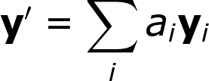
Attention
We build a single vector as a weighted sum:
Attention values indicate the percentage of attention to each node
How to get the attention distribution?
Another neural network of course!

Slide 7
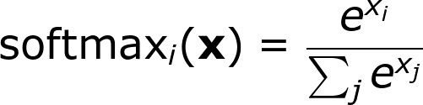
Softmax
Softmax transforms an arbitrary vector into a probability distribution
1
2
-2
0.2
Make positive with exp(x)
2.7
7.4
0.1
1.2
Normalize
24%
65%
1%
11%

Slide 8
Embed, encode, attend, predict
Embedding
RNN
Multilayer Perceptron
Embedding
RNN
Prediction
Embedding
RNN
Fully-Connected
Softmax
Fully-Connected
Fully-Connected

Slide 9
Embed, encode, attend, predict
m_{i} = lookup(w_{i})
e₁,....,e_{n} = RNN(m₁,...,m_{n})
v_{i} = MLP(m_{i})
⍺ = softmax(v)
p = ∑ ⍺_{i} e_{i}
ŷ = MLP(p)
Embed
Encode
Attend
Predict

Slide 10
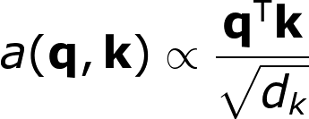
Self-attention
Attention is so powerful, it is all you need! (No RNNs)
Predict three vectors, q, k, v
q₁
q₂
q₃
k₁
k₂
k₃
v₁
v₂
v₃
x₁
x₂
x₃
Linear transform:
q_{i} = A_{q}x_{i} + b_{q}
k_{i} = A_{k}x_{i} + b_{k}
v_{i} = A_{v}x_{i} + b_{v}

Slide 11
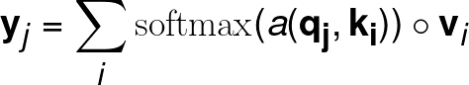
Self-attention
y₁
y₂
y₃
Generate output for each node as attention-weighted sum of the values
q₁
q₁
q₁
k₁
k₁
k₁
v₁
v₂
v₃
x₁
x₂
x₃

Slide 12
Stacking Self-Attention Layers
Self-attention Layer
We can stack self-attention layers just like with other networks
Recurrent nodes need to be calculated one by one
Attention layers can be easily calculated in parallel
Self-attention Layer
Self-attention Layer

Slide 13
Multi-headed Attention Layers
y
We can also train different multiple (different) self-attention models on the same input
Concatenate results and reduce with a MLP
Multi-layer Perceptron
y₁
y₂
y₃
Self-attention Layer

Slide 14
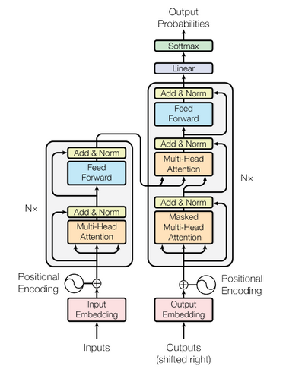
Transformers
Transformer models like BERT produce many state-of-the-art results
Huge stack of multi-head self-attention layers (GPT v3 has 175 billion parameters)

Slide 15
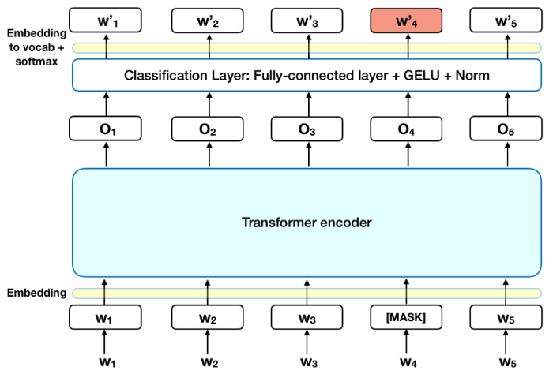
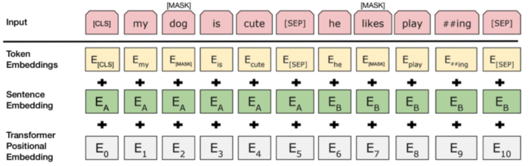
BERT
Masked Language Model
Next Sentence Prediction
Image source: https://towardsdatascience.com/bert-explained-state-of-the-art-language-model-for-nlp-f8b21a9b6270

Slide 16
Discussion
How does encoding and attention help with predicting sentiment for this sentence?
The hotel was superb but the rooms were small

Slide 17
Word Embedding Applications

Slide 18
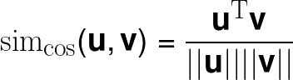
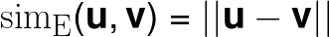
Word Similarity
Word similarity is typically calculated using cosine similarity or Euclidean similarity:
Cosine produces negative values that are hard to interpret
Euclidean distance is often strongly affected by word frequency
Notes:
\text{sim}_\text{cos}(\mathbf{u},\mathbf{v}) = \frac{\mathbf{u}^\text{T}\mathbf{v}}{||\mathbf{u}|| ||\mathbf{v}||}

Slide 19
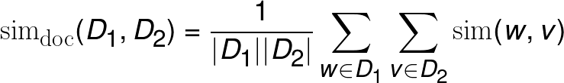
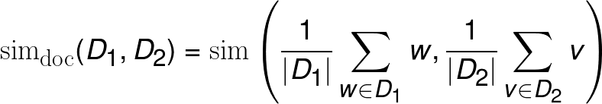
Document similarity
Document similarity can be done either by averaging similarity:
Or by average vectors (mean-pooling):
Both methods fail on all but short documents
Notes:
\text{sim}_\text{doc}(D_1,D_2) = \frac{1}{|D_1||D_2|}\sum_{w \in D_1} \sum_{v \in D_2} \text{sim}(w,v)
\text{sim}_\text{doc}(D_1,D_2) = \text{sim}\left(\frac{1}{|D_1|}\sum_{w \in D_1}w,\frac{1}{|D_2|} \sum_{v \in D_2} v \right)

Slide 20
Analogy
X is to ‘king’ as ‘man’ is to ‘woman’
Mathematically, we wish to find w_{x} ≃ w_{king} - w_{man} + w_{woman}
Or:
analogy(m, w → k) = argmax cos(v, k - m + w)
If we first normalize all vectors
analogy(m, w → k) = argmax [ cos(v,k) - cos(v,m) + cos(v,w) ]
This is called 3CosAdd

Slide 21
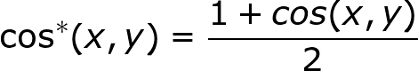
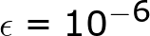
Analogy - 3CosMul
The 3CosAdd method is liable to be dominated by one similarity.
Levy and Goldberg instead propose 3CosMul:
Notes:
\text{analogy}(m, w \rightarrow k) = \arg\max_{v} \frac{\cos^*(\mathbf{v},\mathbf{k})\cos^*(\mathbf{v},\mathbf{m})}{\cos^*(\mathbf{v},\mathbf{w}) + \epsilon}

Slide 22
Projection
Original Vector Space
New Vector Space

Slide 23
Projection
Embeddings from Large General Domain Corpus
Embeddings from Small Domain Specific Corpus
English Embeddings
Under-resourced Language

Slide 24
Arc- Factored
Parsing

Slide 25
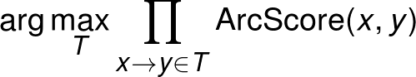
Arc-Factored Parsing
The
big
dog
chased
the
cat
Solve dependency parsing by calculating a function
ArcScore(x,y) = probability that x is connected to y in the parse
Then find the tree, T, that maximizes:

Slide 26
Traditional Approach
Word
Part-of-speech Tags
Neighbouring Words
Neighbouring POS Tags
Distance between words
Direction of relation
....
Support Vector Machine
Arc Score
Features

Slide 27
Deep Learning Approach
?
The
big
dog
chased
the
cat
Word Embedding
Word Embedding
Word Embedding
Word Embedding
Word Embedding
Word Embedding
Part of speech tagger
DET
JJ
NN
VBP
DET
NN
POS Embedding
POS Embedding
POS Embedding
POS Embedding
POS Embedding
POS Embedding

Slide 28
Deep Learning Approach
The
big
dog
chased
the
cat
Distance = +3
Encode as a ‘one-hot’ vector
0
0
0
0
1
0
-3
-2
-1
+1
+2
+3

Slide 29
Embedding the vector
The/DET
big/JJ
dog/NN
chased/VBP
the/DET
cat/NN
Word Embedding (big)
Word Embedding (the)
POS Embedding (JJ)
POS Embedding (DET)
Distance
Prediction Model
ArcScore(big/JJ,the/DET)

Slide 30
Deep learning approach
Loss
Categorical Cross-Entropy Loss
Output
Softmax
Fully-connected Layer
Hidden
Dropout
Sigmoid
Fully-connected Layer
Input
Word Embedding Vectors
POS Embedding Vectors
Distance Vector

Slide 31
How might you improve this parser?

Slide 32
Summarization

Slide 33
Extractive versus abstractive
Galway is a city in West of Ireland and is the sixth most populous city on the island of Ireland.
Galway (/ˈɡɔːlweɪ/ GAWL-way; Irish: Gaillimh, pronounced [ˈɡal̠ʲɪvʲ]) is a city in the West of Ireland, in the province of Connacht. It is the county town of County Galway, which is named after it. It lies on the River Corrib between Lough Corrib and Galway Bay, and is the sixth most populous city on the island of Ireland and the fourth most populous in the Republic of Ireland, with a population at the 2016 Census of 79,934.
Extractive Summarization
Galway is a city in Ireland on the River Corrib.
Abstractive Summarization
Embedding

Slide 34

Using BERT for Abstractive Summarization
BERT is a pre-trained transformer model
Can we use this to do text summarization with less effort?
Based on: Liu and Lapata “Text Summarization with Pretrained Encoders”
https://arxiv.org/pdf/1908.08345.pdf

Slide 35
Extractive summarization
Task: For each input sentence predict if it is in the summary
discarded
discarded
discarded
discarded
sent_{i}
BERT adds a CLS token to each sentence and uses this for next sentence prediction.
This collects the sentence information and can be used as sentence embedding
BERT
Galway
is
a
city
CLS

Slide 36
Extractive Summarization (Liu and Lapata)
Sigmoid Prediction Layer
Feed Forward Network
Stacked Layers (2)
Multi-head Attention Layer
…
…
sent₁
sent_{i}
sent₁

Slide 37
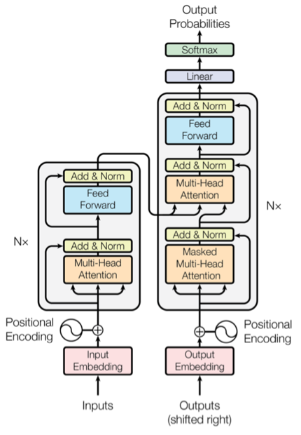
Abstractive Summarization
Transformers were actually designed for machine translation
Abstractive summarisation is a kind of translation (input → summary)
They also fine-tuned BERT with both models (AbsExt)

Slide 38
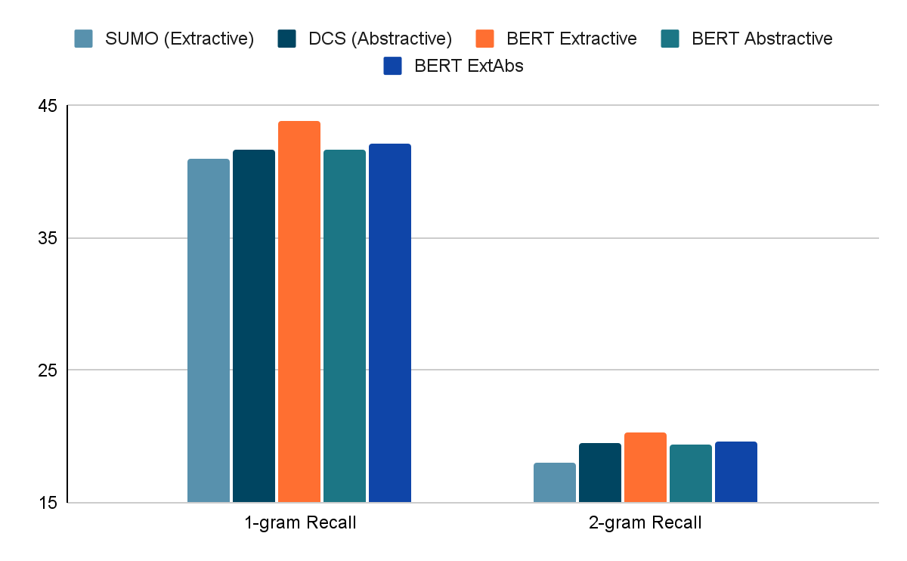
Results (Liu and Lapata)

Slide 39
Summary

Slide 40
Summary
Attention allows models to focus on important words
With attention we don’t need recurrence => transformers
BERT is a pre-trained model
Word embeddings can be useful for
similarity
analogy
projection
Parsing with deep learning
Summarisation (extractive and abstractive)

